Slide 1

Source:https://www.unoosa.org/oosa/en/ourwork/space4sdgs/

Slide 2



Our goals in SDGs
Source:https://www.unoosa.org/oosa/en/ourwork/space4sdgs/
Notes:
As part of Phase 2, we focus on two significant technologies to achieve our goals in Zero Hunger (SDG2), Good Health and Well-Being (SDG3), and Reduced Inequalities (SDG10).

Slide 3
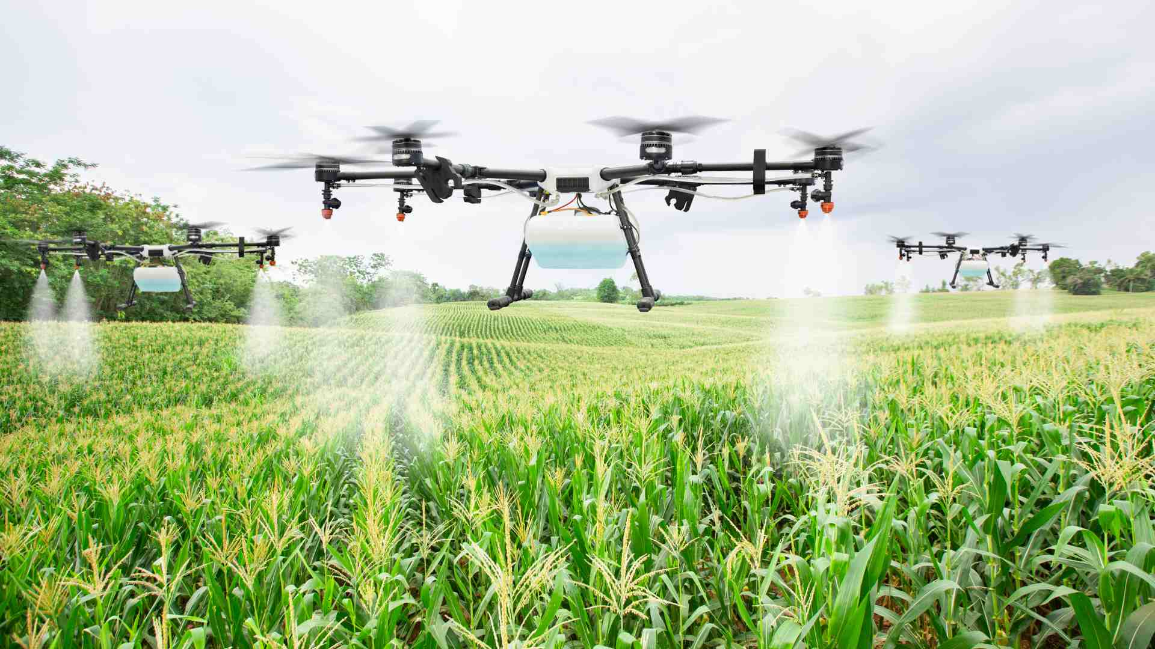
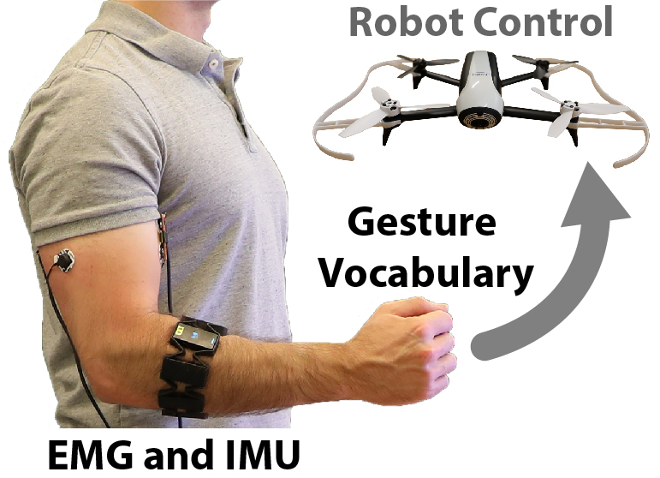
How to achieve our SDGs ?
Source:https://aster-fab.com/producing-more-with-less-precision-farming-to-feed-10bn-people/
Precision
Agriculture
EMG Based
Control of UAV
Source:https://dl.acm.org/doi/abs/10.1145/3319502.3374823?cid=99658989019Multi-Drone
Notes:
The first technology is the application of UAV in precision agriculture, which plays an important role in achieving Zero Hunger (SDG2) and really potential in the future.
The second one is the EMG Based Control of UAV (Unmanned Aerial Vehicle) which is a simple and effective way to permit not only amateur users but also some disabled people to control the UAV.

Slide 4

Precision Agriculture
1. Plant Diseases & Pests
2. Productivity
3. Efficient & Cost-Effective
Source:https://khetigaadi.com/blog/traditional-farming/
Notes:
Nowadays, most of developing countries need to improve the crop productivity. For example, over 70% people are living by farming in India[1]. However, conventional agricultural methods fall short due to challenges like plant diseases and pests, underscoring the divide between developed and developing countries.
To reduce such inequality(SDG10), we can use relative technology in the precision farming which is more helpful and benefitial for productivity.
Using remote sensing technology, precision agriculture can be implemented based on pre-existing maps of targeted variables. Remote sensing offers an efficient and cost-effective method for farmers to collect data, visualize, and analyze the condition of crops and soil throughout various stages of the growth cycle.[5]

Slide 5
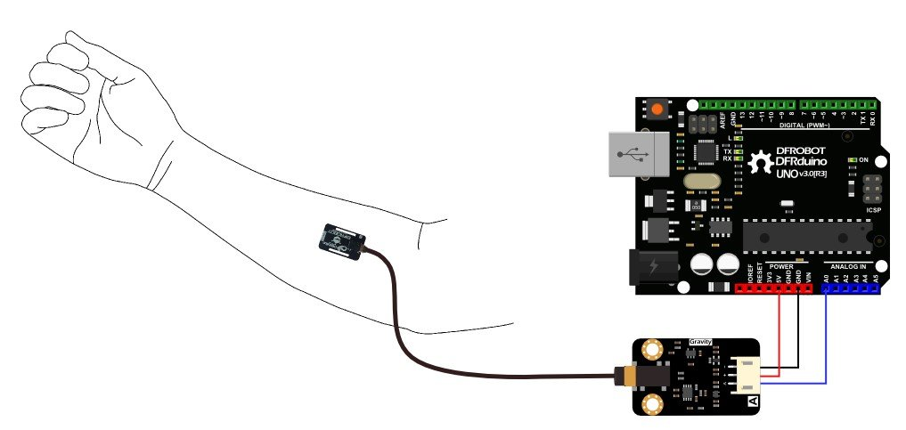
EMG Based Control of UAV
1. Easy to learn
2. Healthy Field
3. Digitalize & Productivity
Source:https://botland.store/gravity-medical-sensors/10833-dfrobot-gravity-analogue-emg-sensor-6959420912780.html
Notes:
This method offers considerable advantages, particularly for persons with disabilities, by leveraging EMG signals. Therefore, we want to use the EMG to control the drone which is simple and easy, even disabled people can learn it quickly. Based on the application of UAV in agriculture, it's also important for crop productivity.
In this way, it's also helpful to achieve our goals of Good Health and Well-Being (SDG3) and Reduced Inequalities (SDG10).
The field of health benefits significantly from EMG technology. Prompt diagnosis is essential and of great importance in medical practices. By comparing the health profiles of individuals who are healthy with those who are not, it becomes possible to facilitate the early detection of not only Alzheimer's disease but also Parkinson’s disease.

